Slide 1
Anomaly Analysis
Codeup Curriculum Logs
Thursday, August 25th 2022
GitHub_Anomaly_Repo
Chenchen Feng & Mijail Q. Mariano
Data Science Team
Codeup, Kalpana Cohort
chenchenfeng79@gmail
mijail.mariano@gmail

Slide 2
Project Goal
The goal of this analysis was to study online curriculum trends and potential suspicious activity. For this study, we use anomaly detection techniques on a Codeup LLC curriculum log and IP address dataset of ~1mil records. Post analysis, we provide insights for Codeup's strategic lesson planning and make recommendations to mitigate suspicious online behavior.
Project Description
We use a scenario-based approach to answer key question to help inform senior Codeup stakeholders on their online curriculum & platforms strategy. In the report we devise insights into the following topics:
Most consistently visited curriculum lessons across cohorts and Codeup programs
By program lessons/topics revisited Post-graduation by Codeup alumni
Lessons and topics least visited/referenced by Codeup students
Cohorts that referenced curriculum lessons/topics more than others across their programs
Information on specific Users/Students who while attending Codeup, rarely accessed curriculum lessons
Potential suspicious activity amongst users, networks/computers, or otherwise

Slide 3
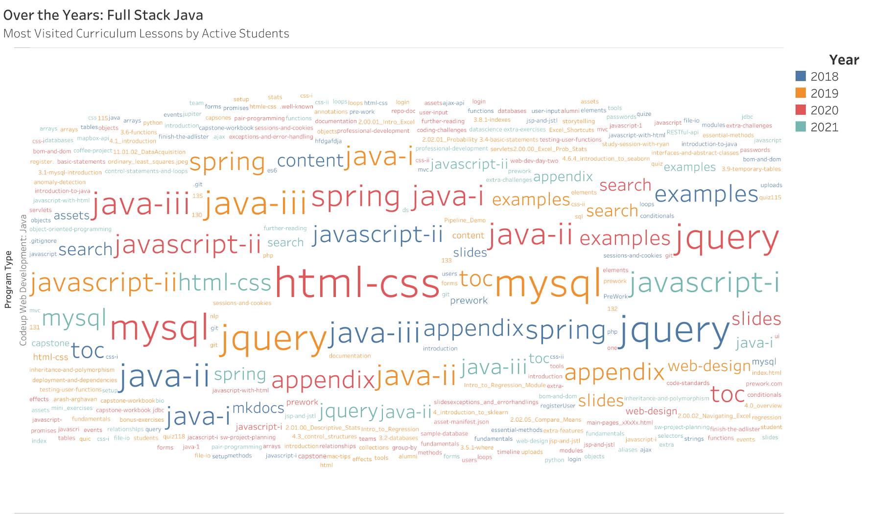

Slide 4
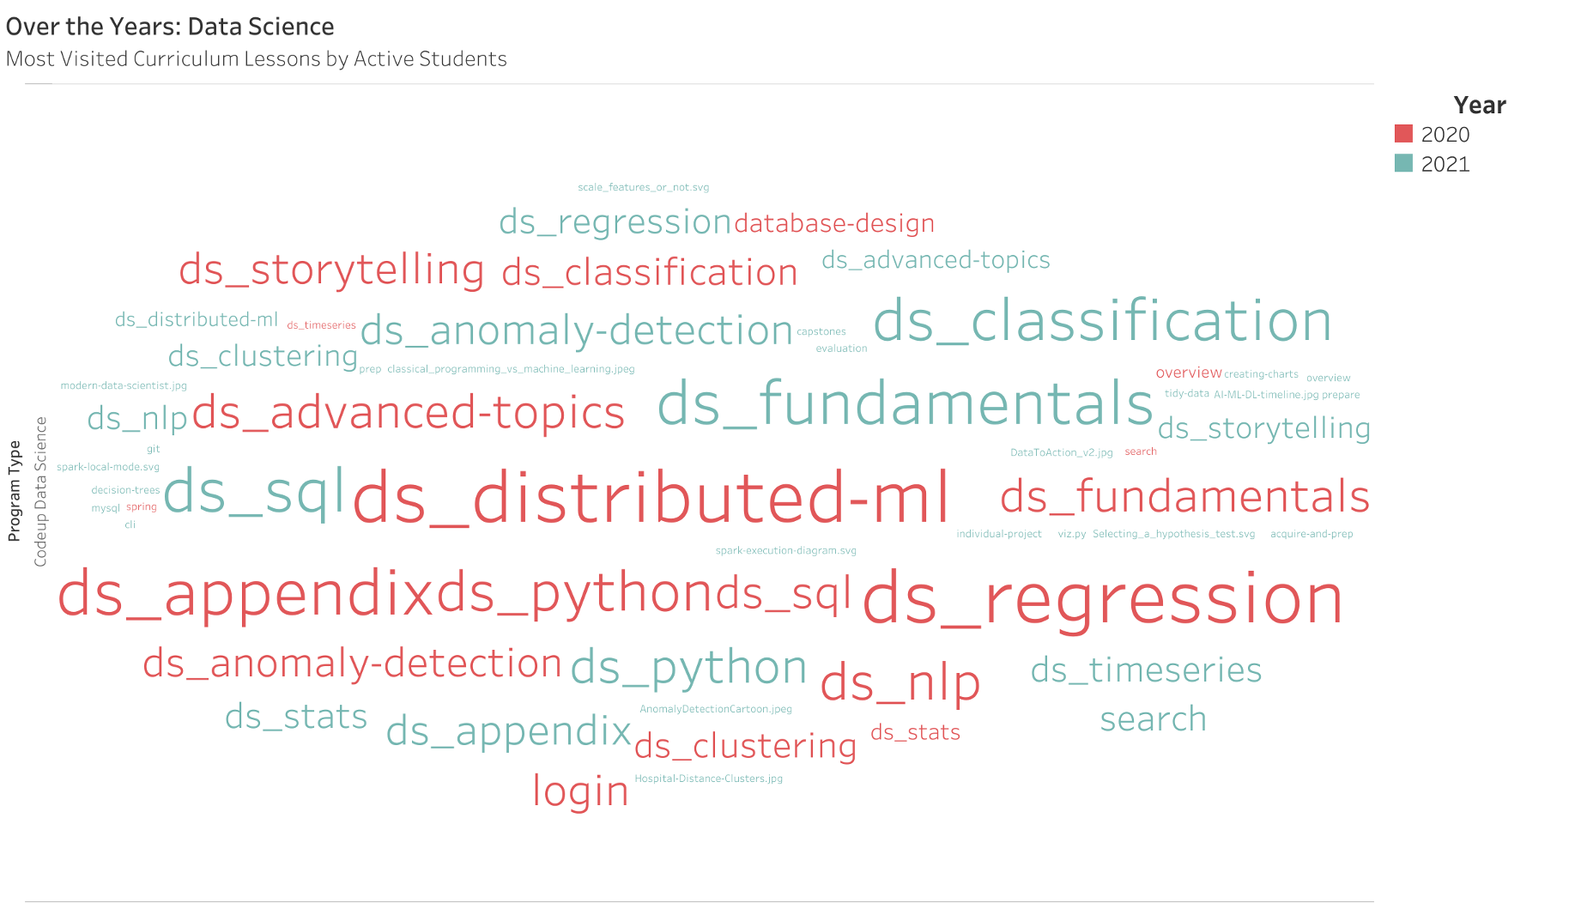

Slide 5
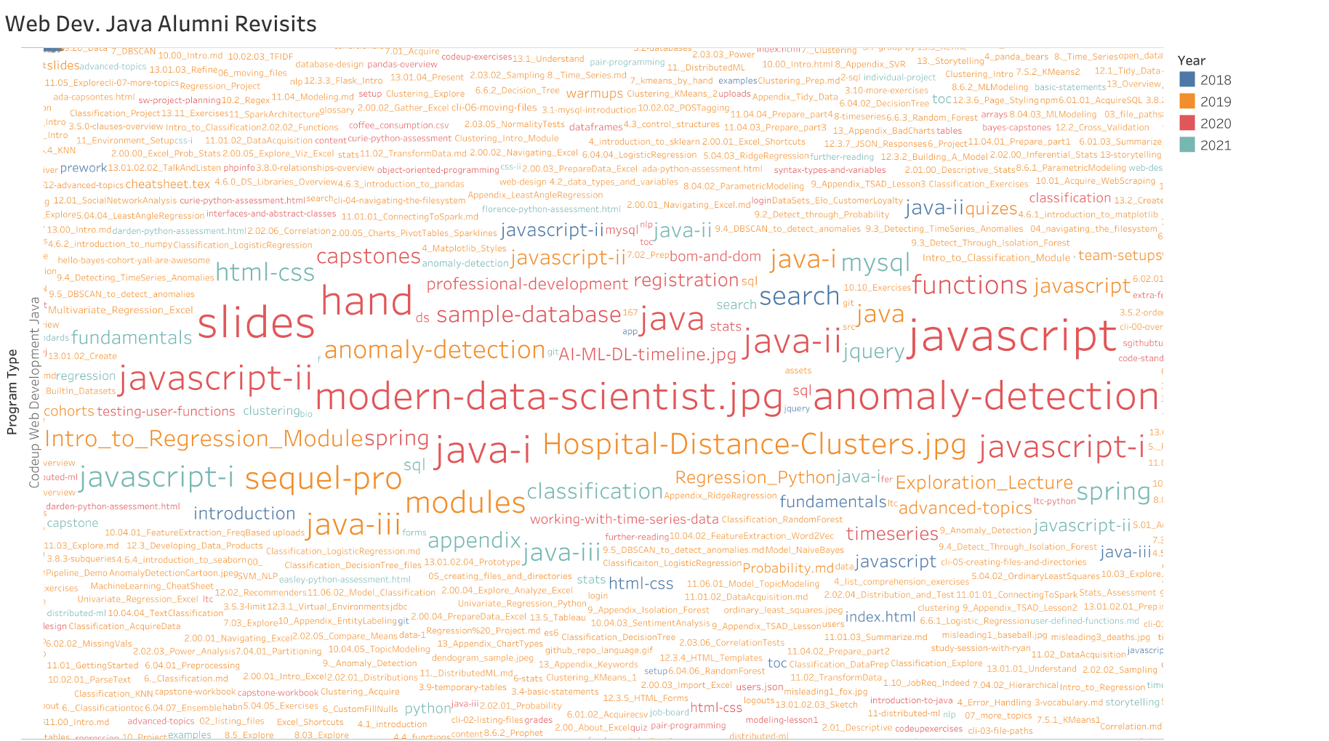

Slide 6
